Slide 1
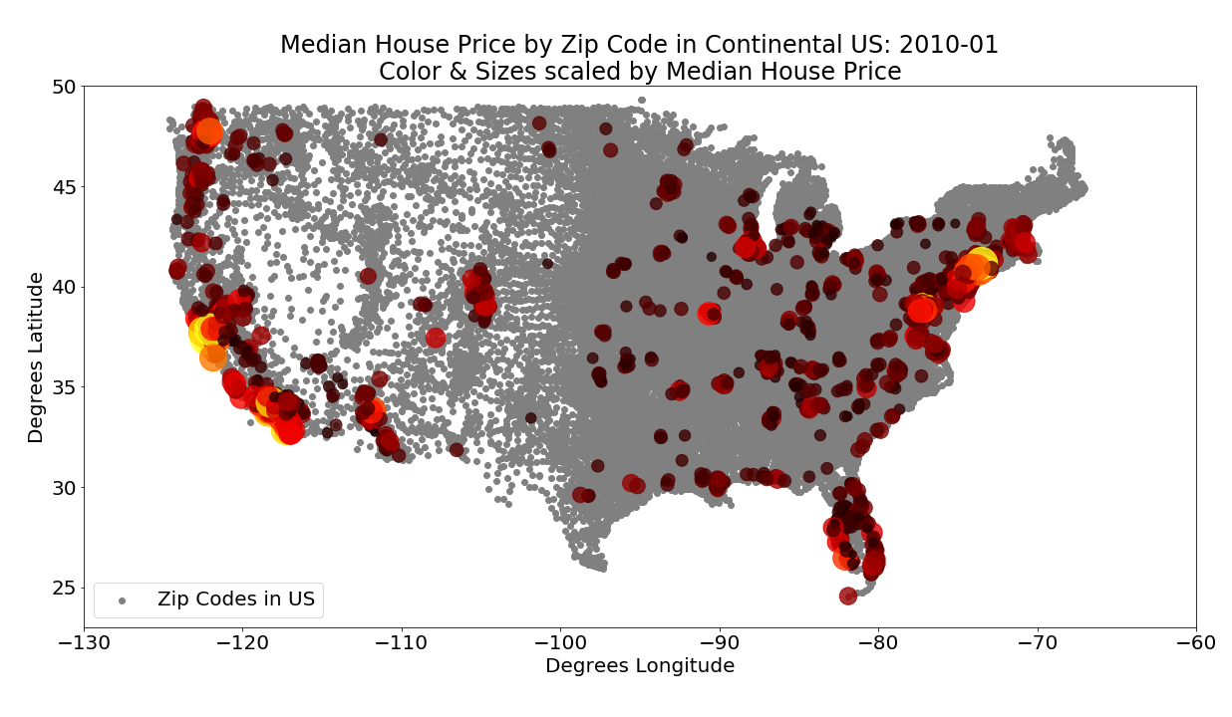
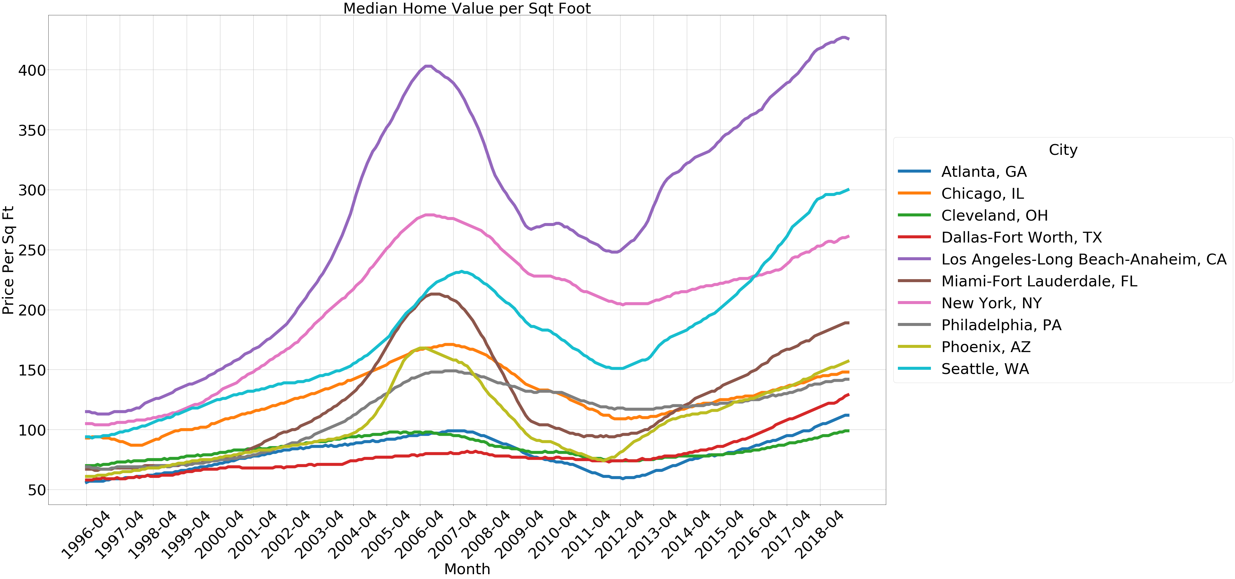
An Analysis of the Factors that Impact Housing Costs in the US
Kim Harrison
Kent Hazen
Tim Tang
Laura De Morneau
9 April 2019

Slide 2
Our approach was to utilize datasets from different sources to determine what factors impact housing prices
Demographics
Severe Weather Events
Rent or Buy?
House Layout
Notes:
How do location demographics impact housing prices? What is the impact of gentrification? (Lead by Kent)
What are the features of the houses & properties that can impact the price of houses? We’ll look specifically at data from LA, Orange, and Ventura counties. (Lead by Kim)
What is the impact of weather and/or environmental factors on housing prices? (Lead by Laura)
What factors impact the decision to rent or buy? (Lead by Tim)

Slide 3
Our approach was to utilize datasets from different sources to determine what factors impact housing prices
How do location demographics impact housing prices?
What is the impact of weather and/or environmental factors on housing prices?
Demographics
Severe Weather Events
Does it make more financial sense to rent or buy in a given city?
How does the layout of a house impact the price?
Rent or Buy?
House Layout
Notes:
How do location demographics impact housing prices? What is the impact of gentrification? (Lead by Kent)
What are the features of the houses & properties that can impact the price of houses? We’ll look specifically at data from LA, Orange, and Ventura counties. (Lead by Kim)
What is the impact of weather and/or environmental factors on housing prices? (Lead by Laura)
What factors impact the decision to rent or buy? (Lead by Tim)

Slide 4
Our approach was to utilize datasets from different sources to determine what factors impact housing prices
House Prices, Amenities
Demographic, City Info
Weather Data

Slide 5
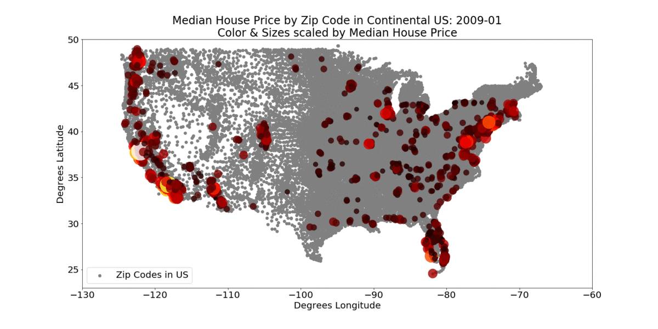
While cleaning our data, we decided to select 10 target cities to analyze housing prices to answer our questions
Seattle
Chicago
Cleveland
New York
Philly
LA
Atlanta
Phoenix
Dallas
Miami
Housing Price Snap Shot every 6 months over the last 10 years

Slide 6
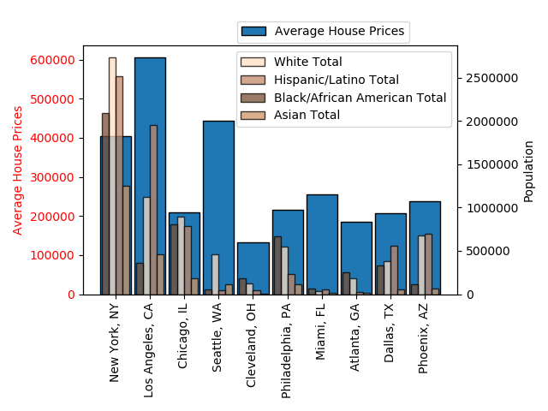
Demographic 1

Slide 7
Demographic 2

Slide 8
Weather 1

Slide 9
Weather 2

Slide 10
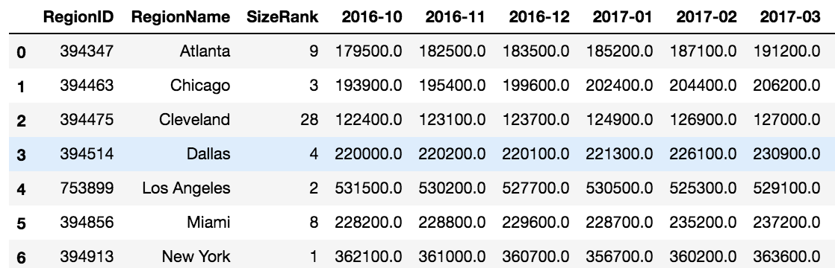
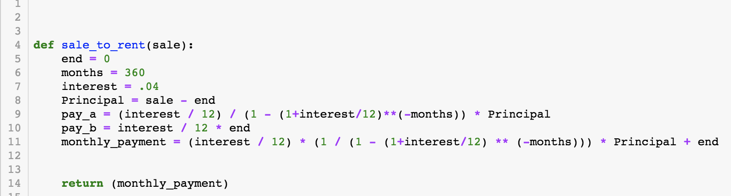
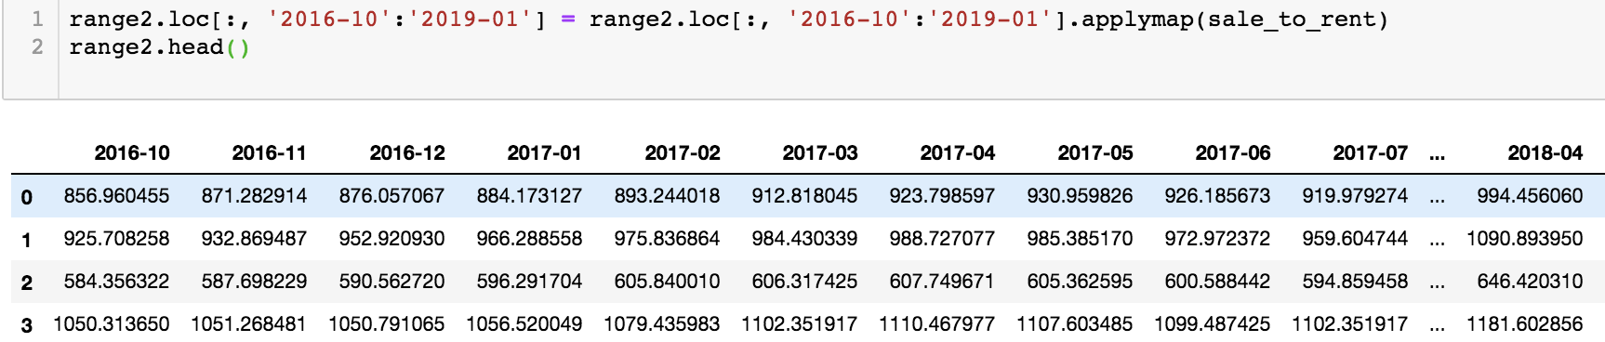
Average house price was converted to mortgage payments using a function to compare buying versus renting
Sales Data Not in Monthly Payment Format
Created a function to convert to monthly payment
Applied the function to each cell

Slide 11
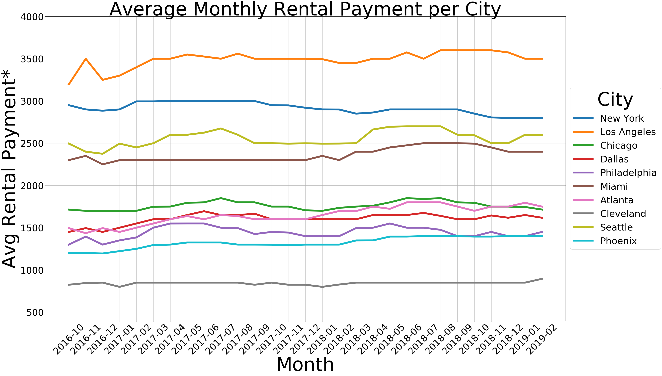
Mortgage payments versus rental payments show if you should buy or rent in a given city

Slide 12
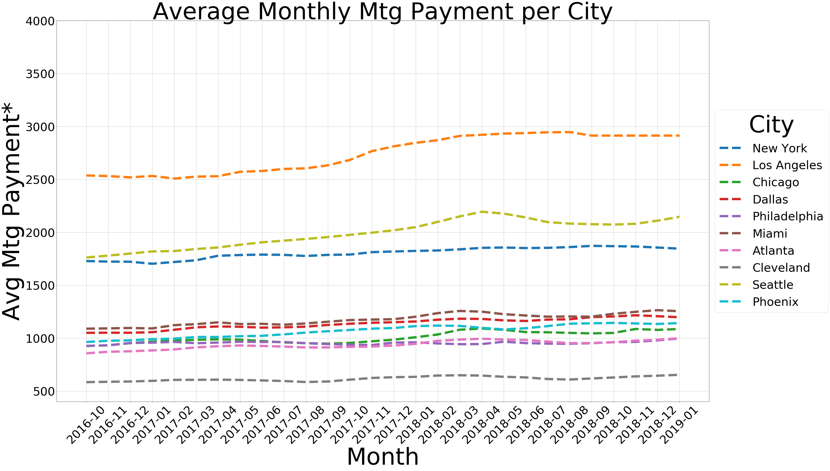
Mortgage payments versus rental payments show if you should buy or rent in a given city

Slide 13
Mortgage payments versus rental payments show if you should buy or rent in a given city
Assumptions:
For Sales Price to Monthly Payment conversion, payments are based on 4% interest rate and 30 year term
Monthly payment comparison does not factor down payment, property taxes, home maintenance
Population used does not reflect rural or suburban area
Notes:
For Sales Price to Monthly Payment conversion, payments are based on 4% interest rate and 30 year term
Monthly payment comparison does not factor down payment, property taxes, home maintenance
Population used does not reflect rural or suburban area

Slide 14
Rentals 2

Slide 15
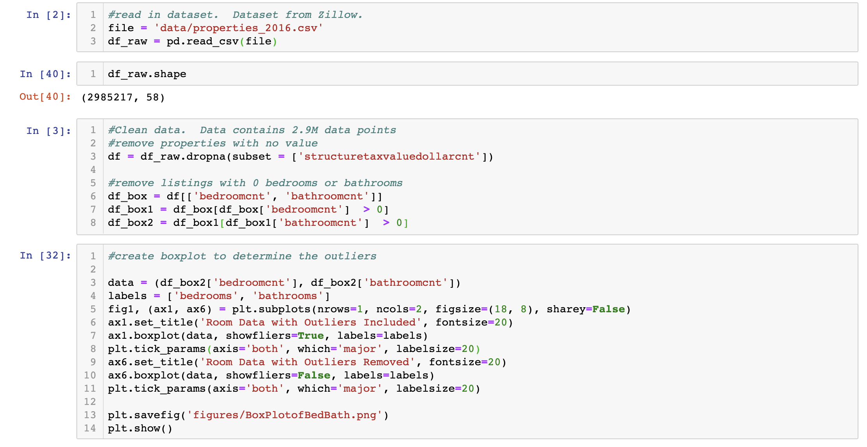
Layout data was analyzed for 2.9 million housing properties in 2016 for LA, Ventura, and Orange County
2.98M data points, 58 columns

Slide 16
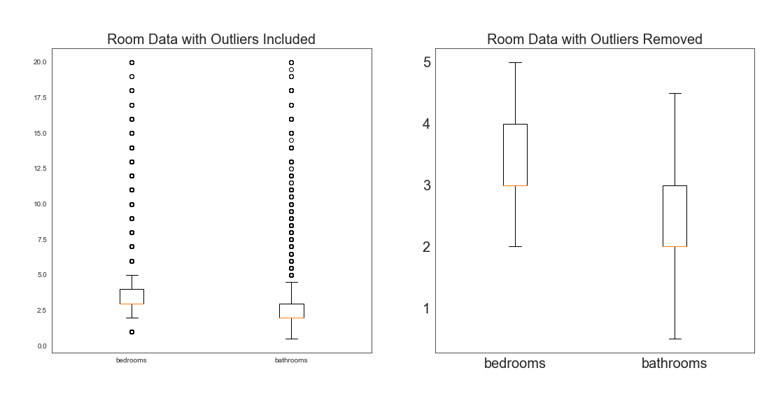
Layout data was analyzed for 2.9 million housing properties in 2016 for LA, Ventura, and Orange County
Data cleanup showed many outliers that needed to be filtered

Slide 17
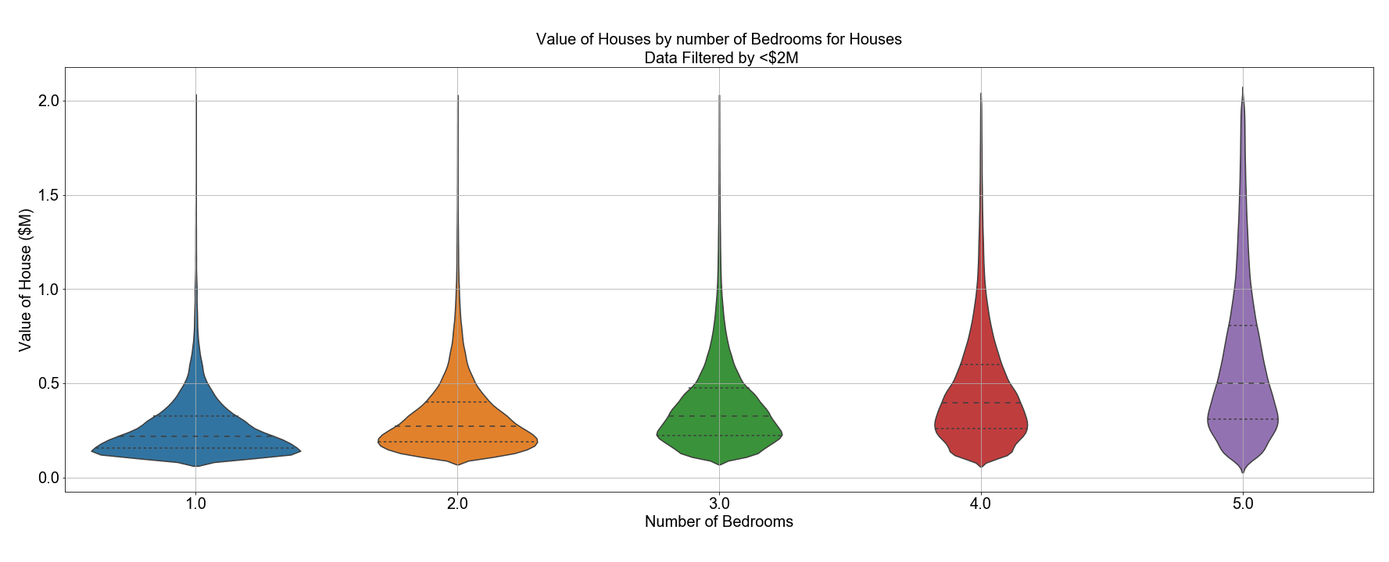
In general, as the number of bedrooms increased, the average house value increased
Avg:
$271,563
$332,724
$388,880
$475,325
$613,218
Increase:
+$61,161
+$56,156
+$86,445
+$137,893

Slide 18
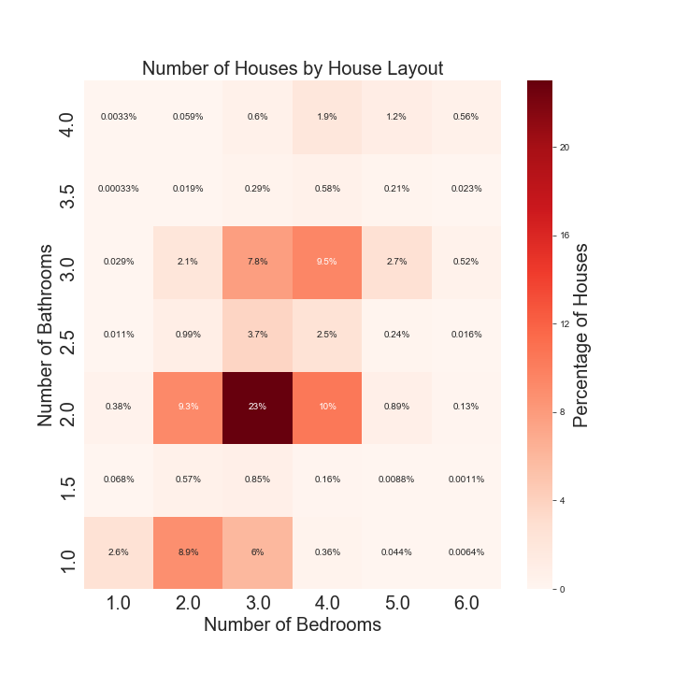
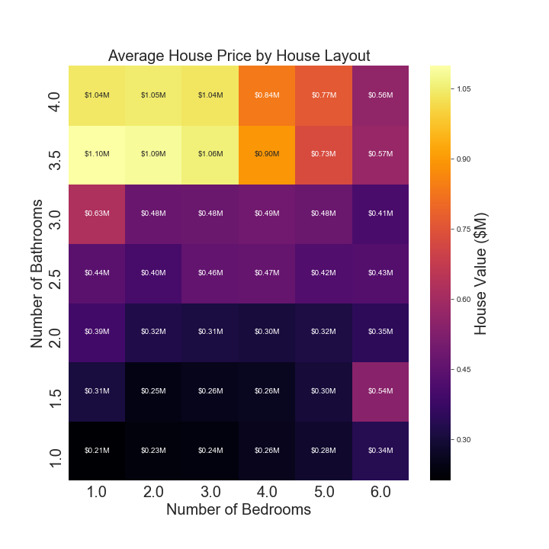
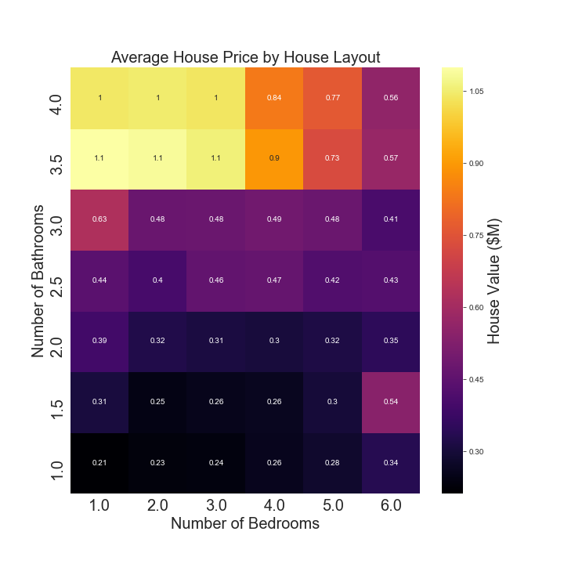
Heatmaps were used to show the most common layouts, as well as the average price per layout

Slide 19
Heatmaps were used to show the most common layouts, as well as the average price per layout

Slide 20
Heatmaps were used to show the most common layouts, as well as the average price per layout
4BR, 3BA: $490,000
3BR, 2BA: $310,000

Slide 21
In summary, demographics, severe weather events, rental markets, and housing layouts all impact housing costs
<Demo summary>
<Severe weather summary>
<rental summary>
Adding a bedroom can increase the value of a house up to $50k - $100k

Slide 22
Post-Mortem

Slide 23
Back Up

